Slide 1
Machine Learning and Big Data
Build a data warehouse
Lecturer:：Gao Zhili

Slide 2
（Introduction）
1. （What is a data warehouse）
1.1 （What is database and relational database RDBMS?）
1.2 （ What is a data warehouse ）
1.3 （Comparison of RDBMS and DataWarehouse）
1.4 （Why is there a data warehouse?）
2. Data warehouse basic structure）
2.1 （Data Mart Architecture）
2.2 （Inmon Enterprise Factory Architecture）
2.3 （Kimball Data Warehouse Architecture）
3. （Basic Concepts of Data Warehouse）
3.1 （ ETL ）
3.2 （Data warehouse layering）
3.3 （dimensional modeling）
3.4 （multidimensional analysis）
4. How to Build a Data Warehouse
4.1 Four-step approach to dimensional modeling
4.2 Application of big data technology

Slide 3
1. （ What is a data warehouse ）
1.1 （ What are databases and relational databases? ）
1.1.1 （ what is a database ）
（ A database is an organized collection of structured information or data, and is a long-term, organized, sharable, and uniformly managed collection of large amounts of data stored in a computer, usually controlled by a database management system (DBMS). In reality, the data, DBMS, and associated applications are collectively referred to as a database system, often simply referred to as a database ）
1.1.2 （ What is a relational database (RDBMS) ）
（It refers to a database that uses a relational model to organize data, which stores data in the form of rows and columns. The rows and columns of a relational database are called tables, and a group of tables constitute a database. Users query to retrieve data in the database. The relational model can be simply understood as a two-dimensional table model, and a relational database is a data organization composed of two-dimensional tables and the relationships between them.）
（So, what is a data warehouse?）

Slide 4
1. （ What is a data warehouse ）
1.2 （What is a data warehouse DataWarehouse?）
1.2.1 （Data warehouse definition）
（ Definition: A data warehouse is a subject-oriented, integrated, relatively stable collection of data that reflects historical changes and is used to support management decisions, usually abbreviated as DW; ）
（ subject-oriented ）
（At a high level, it is an abstract concept that integrates and analyzes the data (multiple business processes/applications) of the enterprise information system for analysis and utilization. Each topic basically corresponds to a corresponding area of analysis.）
（Integrated）
（ A management perspective organizes data from multiple business processes while maintaining consistency, integrity, validity, and accuracy ）
（stable）
（From a certain period of time, it remains unchanged, there is no update operation, delete operation, and the query analysis is the main）
（ changing ）
（Responding to historical changes, the aging of the data warehouse is 5-10 years, or even longer）

Slide 5
1. （ What is a data warehouse ）
1.2 （（ What is a data warehouse ））
1.2.2 （Four characteristics of data warehouse）
1.（subject-oriented）
（RDBMS organizes data for applications/business processes. The degree of abstraction is not high. Data is bound to applications/business processes. Enterprise business activities correspond to the schema of database tables, so it has better operability in specific business processes. , the perspective of organizing data is the operational perspective ）
（DW data warehouse is subject/analysis oriented data organization. The theme is an abstraction of data at a higher management level. In a logical sense, it is the reintegration of the analysis objects (business processes/tables) involved in a macro field of the enterprise from a management perspective. Data is organized into subject domains.）
（Topic-oriented can be independent of data processing logic, suitable for analytical data environment, and suitable for building enterprise global database; its topic-oriented abstraction to a higher degree should emphasize its logical meaning.）

Slide 6
1. （ What is a data warehouse ）
1.2 （ What is a data warehouse ）
1.2.2 （ Four characteristics of data warehouse ）
2.（ Integrated ）
（RDBMS is a transaction-oriented operational database, usually related to some specific applications, and the databases are independent and often heterogeneous. There are many, many different representation methods for different design decisions made by designers of application problems over the years. Applications are inconsistent in terms of coding, naming conventions, actual attributes, and attribute measurement. Each application designer is free to make his own decisions. Or her own design decisions.）
（The data in the DW data warehouse is integrated. The data in the data warehouse is obtained through systematic processing, aggregation and sorting on the basis of the extraction and cleaning of the original scattered database data. Inconsistencies in the source data must be eliminated to ensure that the information in the data warehouse is about the entire data warehouse. Consistent global information for the enterprise.）
（In the data warehouse construction, this is the most critical and complex step. The main tasks are: first, to perform data synthesis and calculation; second, to unify all inconsistencies and contradictions in the source data (similar to the name, Names are synonymous, word lengths are inconsistent, units are inconsistent, etc.).）

Slide 7
1. （ What is a data warehouse ）
1.2 （ What is a data warehouse ）
1.2.2（ Four characteristics of data warehouse ）
3. （stable）
（RDBMSs are operational databases in which the data is usually updated in real time, and the data changes in time as needed.）
(The data of the DW data warehouse is mainly used for enterprise decision analysis. The data operations involved are mainly data query, with few modification and deletion operations, and the data will be retained for a long time.)

Slide 8
1. （ What is a data warehouse ）
1.2 （ What is a data warehouse ）
1.2.2 （ Four characteristics of data warehouse ）
4. （reflect historical changes）
（ The RDBMS operational database mainly cares about the data in a certain current time period, and the time period is generally several months, 1-2 years ）
（The data in the DB data warehouse contains historical information, and the system records the information of the enterprise from a certain point in the past to the present. Through this information, quantitative analysis and prediction of the development process and future trends of the enterprise can be made. The time limit is usually It is 5 to 10 years.）
（RDBMS operational databases contain "current value" data whose accuracy is valid at the time of access, as well as current value data that can be updated. The data in the DW data warehouse is a series of snapshots of the data generated at a certain moment.）
（The table structure of RDBMS operational data may or may not contain time elements such as year, month, day, etc. The table structure of the DB data warehouse must includeContains a time element to indicate the historical period of the data. The data in the data warehouse contains a large amount of comprehensive data, many of which are related to time, such as by time periodPerform aggregated or time-sliced sampling. As time changes, the data warehouse needs to continuously add new data and delete old data.）

Slide 9
1. （ What is a data warehouse ）
1.3 （Comparison of RDBMS and DataWarehouse）
1.3.1 (Concept comparison)
(First, we already knowDW data warehouse is a subject-oriented, integrated, relatively stable data collection that reflects historical changes,Used to support management decisions.)
(In contrast, redefine the relational database)
(RDBMS is oriented to a single business process/action (purchasing a commodity), so it is non-integrated (a single business process is not integrated), unstable (often added, deleted and modified), and does not reflect historical changes (shorter time) ) data collection used to record business actions and store business process data)

Slide 10
1. （ What is a data warehouse ）
1.3 (Comparison of RDBMS and DataWarehouse)
1.3.2 (Feature comparison(一))
（comparison）
（data content） | （current state data） | (historical, complete, reflecting historical changes)
（Application scenarios） | （For business transaction process, for business operation procedures, repeat processing） | (Subject-oriented, across multiple business processes, analyze and support strategic decisions)
（design theory） | (Follow the three paradigms and avoid redundancy) | （Paradigm violation, appropriate redundancy）
（data structure） | (Highly structured schema, complex, suitable for manipulation, computation) | Schema，（Non-standardized schema, such as star schema or snowflake schema; simple, suitable for analysis,）
（data storage） | (row storage) | （columnar storage）
（data change） | (Frequent addition, deletion, modification and checking) | （Add-on, no-delete, no-change, reflect historical changes）
（suitable workload） | (Transaction processing) | Analytics, Reporting, Big Data）

Slide 11
1.（ What is a data warehouse ）
1.3 （RDBMS和DataWarehouse对比）
1.3.2 Feature comparison （二））
（comparison） | （Transaction database） | （data warehouse ）
（Data processing method） | （Frequent, small batch, high concurrency, low latency） | （Infrequent, high-volume, high-throughput, with latency）
（data access） | （Only a small number of records are accessed per transaction） | （Some transactions may access a large number of records）
（Response time） | （Measured in seconds） | （Measured in seconds, minutes, or even hoursMeasured in seconds, minutes, or even hours）
（usage frequency） | （high） | （medium to low）
（data source） | （A single source of data (typically a transactional system)） | （Data collected and normalized from multiple sources, multiple business systems）
（data size） | （Smaller, tens of gigabytes, hundreds of gigabytes） | （Larger, hundreds of gigabytes, terabytes, or even petabytes）

Slide 12
1. （ What is a data warehouse ）
1.3 （Comparison of RDBMS and DataWarehouse）
1.3.3 （Analysis method comparison: OLTP vs OLAP）
OLTP
OLAP
(detailed) (integrated or derived)
(current) (historical)
Updatable) (Not updatable)
(needs to be known in advance) (Need not known in advance)
(Compliant with system life cycle) (completely different life cycle)
(high performance requirements) (Relatively loose on performance requirements)
(transaction driven) (data driven)
(application oriented) (Analysis Oriented)
(Small amount of data in one operation) (Large amount of data in one operation)
(Support daily affairs) (Support management needs)

Slide 13
1. （ What is a data warehouse ）
1.4 (Why there is a data warehouse)
(Examples of e-commerce development)
(In the first stage, the business is single, the traffic is small, and the structure is simple. The front-end of the web page for ordering + several servers + MySQL database can satisfy basic queries. It's like a workshop period.)
（In the second stage, traffic, customers and orders have increased, and ordinary queries have been under pressure, and the architecture has become multiple servers and multiple business databases (large volume + sub-database and sub-table). The business data and indicators in this stage are still acceptable. Barely query from the business database. Initially entered into industrialization.）
(In the third stage, after 3-5 years, the business has grown exponentially, the amount of data has increased sharply, the company's management roles have increased, and the issues that executives are concerned about, from the initial "how much was yesterday's income", gradually evolved to refined analysis, Cluster analysis of specific users, the performance of specific users in specific usage scenarios, such as "the relationship between the purchase behavior of cosmetic products of 20-30-year-old female users in the first quarter of the past five years and the company's promotion plan ".)
(This kind of very specific and key issues that can play a key role in the company's decision-making is basically difficult to retrieve from the business database. the reason is?)
(Therefore, it is necessary to reorganize the data, and a new data warehouse architecture is required to meet the company's strategic needs;)
Notes:
1、业务数据库中的数据结构是为了完成交易而设计的，不是为了而查询和分析的便利设计的。
2、业务数据库大多是读写优化的，即又要读（查看商品信息），也要写（产生订单，完成支付）。因此对于大量数据的读（查询指标，一般是复杂的只读类型查询）是支持不足的。

Slide 14
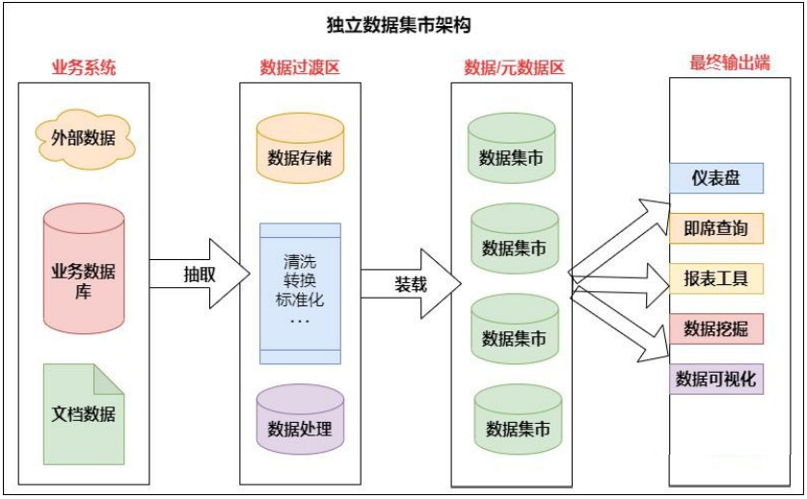
2.（Data warehouse basic structure)
2.1 (Data Mart Architecture)
2.1.1 (Standalone Data Mart Architecture)

Slide 15
2. (Data warehouse basic structure)
2.1 (Data Mart Architecture)
2.1.1 (Standalone Data Mart Architecture)
(Independent data marts Focus on a single subject area of concern to departments, and data marts are deployed on a departmental basis, regardless of enterprise-level information sharing and integration. For example, manufacturing, marketing, and other departments each have their own data marts.)
(Advantages: Because the business of a department is simpler than that of the entire enterprise, and the amount of data is much smaller, the independent data mart of the department has the characteristics of short cycle and quick effect.)
(shortcoming:• From a business perspective, when the analytical needs of a department expand, or when data needs to be analyzed across departments or subject domains, the independent data market will appear inadequate.• When there is ambiguity in the data, for example, the same product is defined differently in department A and department B, information comparison between departments will not be possible.•Each department uses different technologies, establishes different ETL processes, and handles different transaction systems, and there will be data overlap and overlap between multiple independent data marts, and even data inconsistencies.)

Slide 16
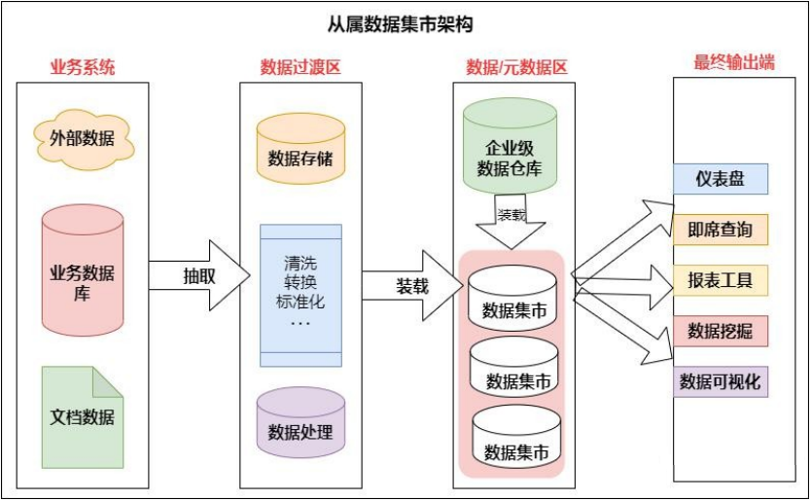
2. (Data warehouse basic structure)
2.1 (Data Mart Architecture)
2.1.2 (Dependent data mart schema)

Slide 17
2. (Data warehouse basic structure)
2.1(Data Mart Architecture)
2.1.2 （Dependent data mart schema)
（The data of the subordinate data marts originates from the data warehouse. The data in the data warehouse is integrated, reconstructed, aggregated and passed to the subordinate data marts.）
（ The main benefits of building a subordinate data mart are: ）
（ Performance: When there is a problem with the query performance of the data warehouse, you can consider establishing several subordinate data marts to move queries from the data warehouse to the data mart. ）
（Security: Each department has full control over their own data.）
（Data consistency: Because the data source of each data mart is the same data warehouse, data inconsistency is effectively eliminated.）

Slide 18
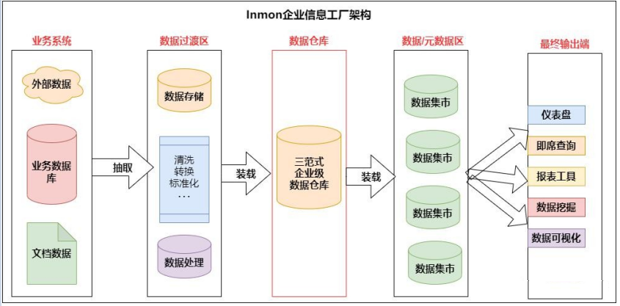
2. (Data warehouse basic structure)
2.2 （Inmon Enterprise Factory Architecture）
（Inmon Enterprise Factory Architecture: The data warehouse is an integrated repository of detailed data. The data in it is captured at the lowest level of granularity, stored in a relational database that satisfies the three-paradigm design.）

Slide 19
2. (Data warehouse basic structure)
2.2 （Inmon Enterprise Factory Architecture）
（Inmon Enterprise Factory Architecture: The data warehouse is an integrated repository of detailed data. The data in it is captured at the lowest level of granularity, stored in a relational database that satisfies the three-paradigm design.）
（Data mart: It is a department-level data mart, a department-level view oriented to subject data, and the data is obtained from an enterprise-level data warehouse. Data may be aggregated as it enters departmental data marts. Data marts are designed using multidimensional models for data analysis. It is important that all reporting tools, BI tools, or other data analysis applications query data from the data mart, not the enterprise data warehouse directly）
（Pros: Easy to understand business）
（Disadvantages: poor performance, follows 3-paradigm, causes unnecessary associations when generating data marts）

Slide 20
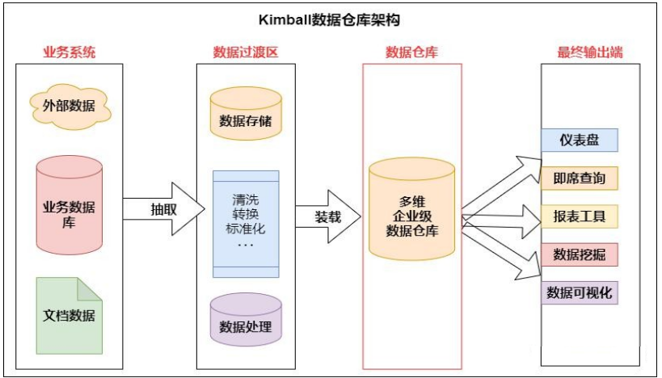
2. (Data warehouse basic structure)
2.3 （Kimball Data Warehouse Architecture）
（Kimball's data warehouse contains highly granular enterprise data and is designed using a multi-dimensional model, which also means that the data warehouse consists of dimension tables and fact tables in a star schema. Analysis systems or reporting tools can directly access the data in the multidimensional data warehouse.）
（ Advantages: Excellent performance, usually the analysis results can be obtained within 3 associated queries, most of which are 1 or 2 times; ）

Slide 21

2. (Data warehouse basic structure)
2.3 （Kimball Data Warehouse Architecture）
（ Overall architecture of Kimball warehouse ）
数据获取（data collection
（data collection）
（data management）
（data usage）
（source data）
（data conversion）
（central data warehouse）
(information display)
(business user)
(Mysql or Es etc.)
（report）
（OLAP users）
(5 application layer app)
business system 1
（decision maker）
ETL
extract
convert
filter
load
（Hive data warehouse）
business system 2
数据
集市
(datamarket)
（query now）
（Analyst）
（4 service layer dws）
（applicationserver）
（researcher）
business system 3
（3 middle layer dwm）
数据立方体
（data cube）
（multidimensional analysis）
（web user）
（2 layers of detail dwd）
（Inquirer）
(external information)
（1 original layer ods）
（data mining）
（Direct User (Client)）

Slide 22
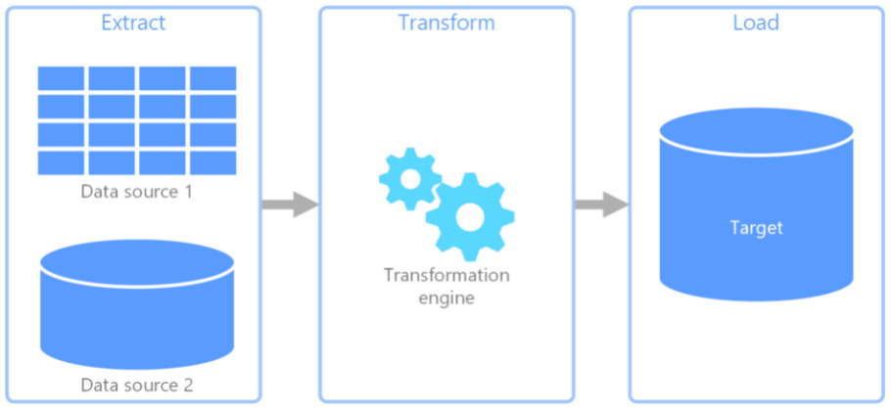
3. （Basic Concepts of Data Warehouse）
3.1 ETL？
（ETL is the abbreviation of Extract/Transformation/Load, which is the process that data needs to go through during the flow of data from the business system to the data warehouse. Three English letters represent three actions, which in Chinese means data extraction, transformation, and loading;）
（ETL tools are tools used to extract, transform and load data. Specific ETL tools include: data extract, data transform, data cleaning, and data loading.）

Slide 23
3. （Basic Concepts of Data Warehouse）
3.1 ETL
（4 Key Concepts of ETL）
（1） （Data Extract）
（ From a data warehouse perspective, not all data in a business database is necessary for decision support. Usually, the data warehouse organizes data according to the subject of analysis, and we only need to extract the part of the data necessary for the systematic analysis. For example, if a supermarket decides to build a data warehouse with the theme of analyzing customer purchasing behavior, we only need to extract the data related to customer purchasing behavior, and there is no need to put the data of supermarket service employees into the data warehouse. ）
（2）（Data Transform）
（Since each business system is designed by different people and is likely to use products from different database manufacturers, such as IBM DB2, Oracle, Informix, Sybase, NCR Teradata, SQL Server, etc., the data types provided by various database products may be different. Therefore, Data in different formats needs to be converted into a unified data format. Such as the time format "year/month/day", "month/day/year", "day-month-year" inconsistency and so on.）

Slide 24
3.数据仓库基本概念（Basic Concepts of Data Warehouse）
3.1 ETL
（4 Key Concepts of ETL）
（3） （Data Clean）
（Because enterprises often build different business databases, for example, a telecom operating company has business systems such as billing database, financial database, customer service database, customer complaint database, etc. The so-called "cleaning" is to clean wrong and inconsistent data before entering the data warehouse Correct or delete, so as not to affect the correctness of the decision support system decision.）
（4（Data Load）
（The data loading component is responsible for loading data into the data warehouse according to the table structure defined by the physical data model, including steps such as clearing data fields, filling blanks, and checking validity.）

Slide 25
3.数据仓库基本概念（Basic Concepts of Data Warehouse）
3.1 ETL
（Data extraction strategy）
（Source System Data Feature Category） | （Data features） | （Extraction strategy）
（INSERT） （flow-through growth） | （Data is generated incrementally and does not involve updating existing data） | （Incremental update）
（UPDATE） （change update） | （Update existing data） | （change update）
（INSERT/DELETE+UPDATE） （Combining the two） | （While generating new data incrementally, it also updates existing data） | （Incremental update + change update or full update）

Slide 26
3. （Basic Concepts of Data Warehouse）
3.2（Data warehouse layering）
3.2.1 （Why stratify?）
1、（simplify complex problems）
（Decompose a complex task into multiple steps to complete, each layer only handles a single step, which is relatively simple and easy to understand）
2、（clear data structure）
（Each data layer has its scope, so that we can more easily locate and understand when working with tables. It is easy to maintain the accuracy of the data. When there is a problem with the data, you don't need to repair all the data, you only need to start repairing from the problematic steps.）
3、（Reduce repetitive development）
（ Standardized data layering, the intermediate layer data passed, can greatly reduce repeated calculations and increase the reusability of a calculation result ）
4、（Isolate raw data）
（ Whether it is data anomaly or data sensitivity, decoupling real data from statistical data ）

Slide 27
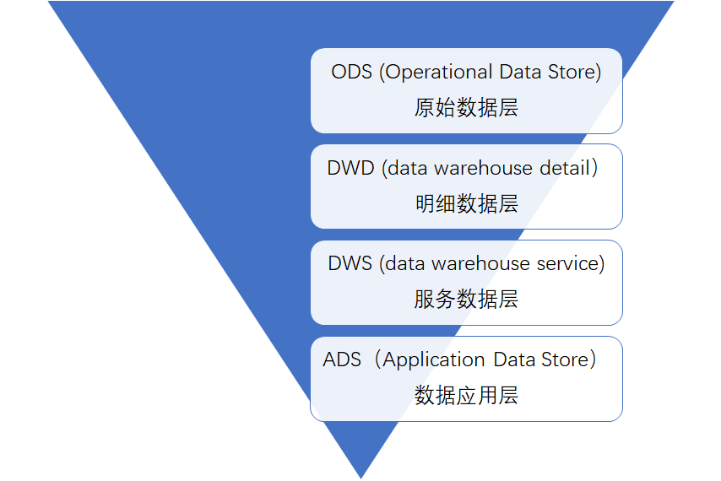
3. （Basic Concepts of Data Warehouse）
3.2 （Data warehouse layering）
3.2.2 （3.2.2 Data warehouse hierarchical structure）
1、（1. ODS layer (original data layer)）
（The original data of the business system is stored, and the
data is kept as it is without processing.）
2、（DWD layer (detailed data layer)）
（The structure and granularity are consistent with the ODS layer, and the data of the ODS layer is processed.Row cleaning (removes nulls, dirty data, data out of limits).）
3、（DWS layer (service data layer)）
（Based on DWD, light aggregation is performed. Generally aggregated to the granularity of the user's day, the device's day, the merchant's day, the commodity's day, and so on.）
4、 (APP layer (data application layer)
(Facing the actual data requirements, it is composed of various statistical reports based on the data of the DWD or DWS layer. The statistical results are finally synchronized to the RDBMS for BI or application system query.)

Slide 28
3. （Basic Concepts of Data Warehouse）
3.3 (dimensional modeling)
3.2.1 (Attributes, Dimensions, Measures)
1. (Attributes)
(Entity refers to the subject of dependence, which is an object of our analysis. For example, when we analyze the sales of goods, such as the sales volume of Huawei mobile phones in the past six months, then Huawei mobile phones are an entity; when we analyze the activity of users, users are a entity. Of course, entities can also not exist in reality, such as virtual business objects, activities, members, etc. can be regarded as an entity.)
(The existence of entities is for business analysis. As a screening dimension of analysis, it has attributes that describe itself and has analyzable value.)

Slide 29
3. （Basic Concepts of Data Warehouse）
3.3 (dimensional modeling)
3.2.1 (Attributes, Dimensions, Measures)
2. (Dimensions)
(The dimension is the angle of looking at the problem, analyzing the business data, and establishing the dimension from which angle is analyzed. Therefore, a dimension is a quantity used to analyze data. For example, if you want to analyze product sales, you can choose to analyze by commodity category, which constitutes a dimension. All commodity categories are grouped together to constitute a dimension. surface.)
(Common dimensions are, time, area, commodity;)

Slide 30
3. （Basic Concepts of Data Warehouse）
3.3 dimensional (modeling)
3.2.1 Attributes, Dimensions, Measures)
3.( Measures)
(A metric is a numeric value on a business process node. Such as sales, price, cost and so on.)
(The measures in the fact table can be divided into three categories: fully additive, semi-additive, and non-additive.)
（1） (Completely additive measures are the most flexible and useful, such as sales, sales, etc., which can be aggregated in any dimension;)
（2） (Semi-additive measures can summarize some dimensions, but not all dimensions. Difference is a common semi-additive measure, which can be added across all dimensions except the time dimension;)
（3） (Completely non-additive measures, such as ratios. For such non-additive metrics, a good approach is to store as many fully additive components of the non-additive metric as possible and aggregate these components into the final result set before computing the final non-additive fact .)

Slide 31
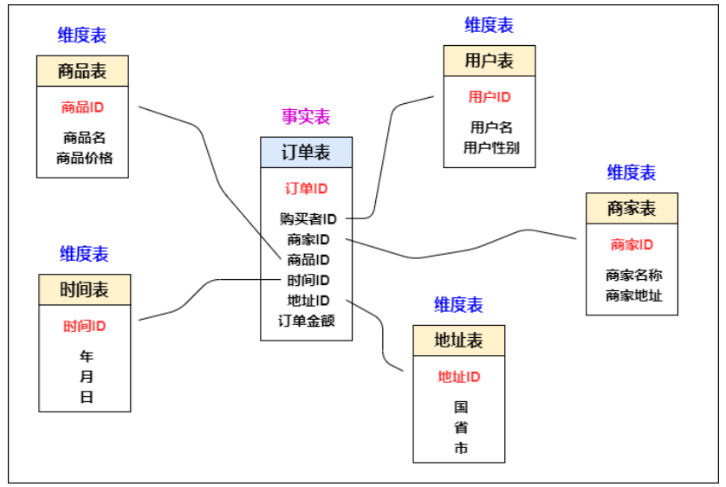
3. （Basic Concepts of Data Warehouse）
3.3 (dimensional modeling)
3.2.2 (Table Types for Dimensional Modeling)
(Dimensional modeling includes two types of tables: fact table and dimension table)
(In general, no strict adherence to canonical design principles is required in a data warehouse. Because the dominant function of the data warehouse is analysis-oriented, mainly query, and does not involve data update operations. The design of the fact table is based on the ability to correctly record historical information, and the design of the dimension table is based on the ability to aggregate the subject content from an appropriate angle.)

Slide 32
3. （Basic Concepts of Data Warehouse）
3.3 (dimensional modeling)
3.2.2 (Table Types for Dimensional Modeling)
(Dimensional modeling includes two types of tables: fact table and dimension table)
1. (fact table)
(Operational events that occur in the real world produce measurable values that are stored in fact tables. At the lowest level of granularity, a fact table row corresponds to a metric event, and vice versa.)
(A fact table represents a measure on the subject of the analysis. For example, a purchase behavior we can understand as a fact.)
(The order table in the figure is a fact table. It can be understood that it is an operational event that occurs in reality. Every time we complete an order, a record will be added to the order.)
(Features of the fact table: There is no actual content in the table. It is a collection of a bunch of dimension primary keys. These dimension primary key IDs can correspond to a record in the dimension table. The fact table contains foreign keys associated with each dimension table and can be associated with the dimension table. The measure of the fact table is usually of numeric type, and the number of records will continue to increase, and the size of the table data grows rapidly.)

Slide 33
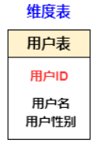
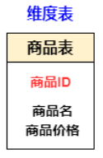
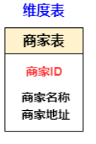
3. （Basic Concepts of Data Warehouse）
3.3 (dimensional modeling)
3.2.2 (Table Types for Dimensional Modeling)
(Dimensional modeling includes two types of tables:
fact table and dimension table)
2. (dimension table)
(Each dimension table contains a single primary key column. The primary key of a dimension table can be used as a foreign key to any fact table it is associated with, of course, the description environment of the dimension table row should correspond exactly to the fact table row. Dimension tables are usually wide, flat, non-canonical tables containing a large number of low-grained text attributes.)
(A dimension represents an angle from which you want to analyze data. For example, if you want to analyze product sales, you can choose to analyze by category or by region. Each category constitutes a dimension. The user table, commodity table, and merchant table in the graph of the fact table are all dimension tables. These tables have a unique primary key, and then store detailed data information in the table.)

Slide 34
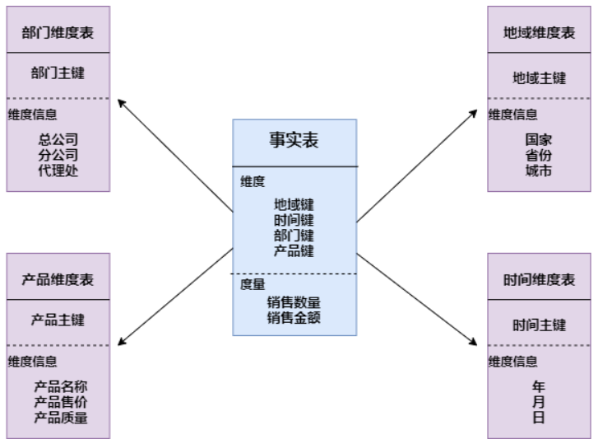
3. （Basic Concepts of Data Warehouse）
3.3 (dimensional modeling)
3.2.3 (Dimensional Modeling Models)
1. (star schema)
(The star schema is centered on the fact table, and all dimension tables are directly connected to the fact table, like stars. The star schema consists of a fact table and a set of dimension tables. Features:)
a. (The dimension table is only associated with the fact table, and there is no relationship between the dimension tables;)
b. (The primary key of each dimension table is a single column, and the primary key is placed in the fact table as a foreign key connected on both sides;)
c. (With the fact table as the core, the dimension tables are distributed in a star shape around the core;)

Slide 35
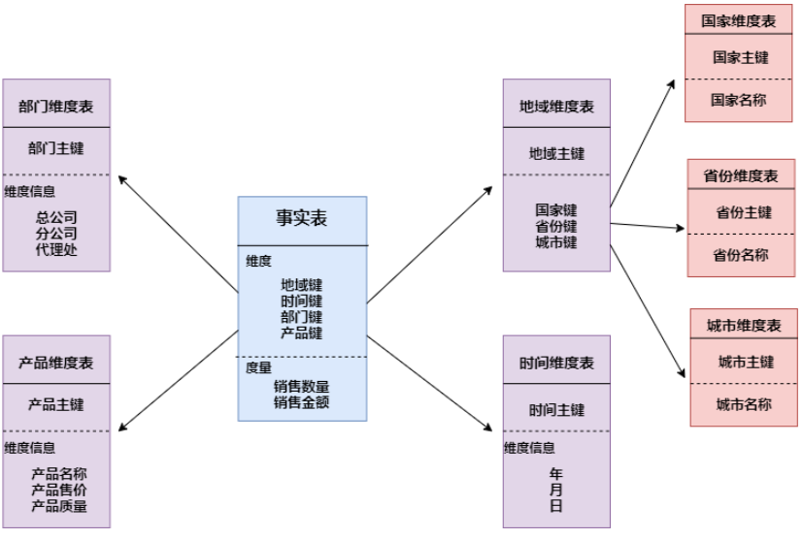
3. （Basic Concepts of Data Warehouse）
3.3 (dimensional modeling)
3.2.3 (Dimensional Modeling Models)
2. (snowflake model)
(The snowflake schema is an extension to the star schema)
(The dimension table of the snowflake schema can have other dimension tables. Although this model is more standardized than the star schema, because this model is not easy to understand, the maintenance cost is relatively high, and the performance needs to be associated with multiple dimension tables. Also lower than the star schema. So generally not very common)

Slide 36
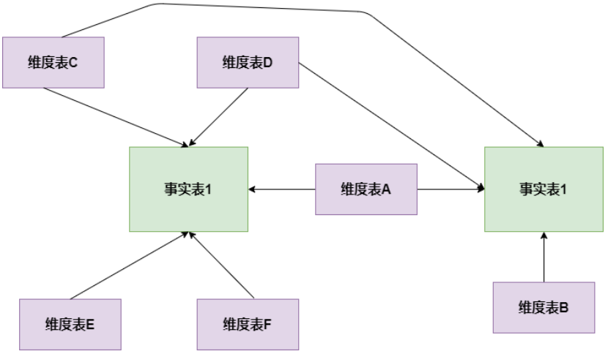
3. （Basic Concepts of Data Warehouse）
3.3 (Dimensional Modeling)
3.2.3 (Dimensional Modeling Models)
3. (Constellation Model)
(The star schema is based on one fact table, and the constellation model is based on multiple fact tables and shares dimension information.)
(The two dimensional modeling methods introduced above are multidimensional tables corresponding to single fact tables, but in many cases there are more than one fact table in the dimension space, and one dimension table may also be used by multiple fact tables. In the later stage of business development, most dimensional modeling adopts the constellation model.)

Slide 37

3. （Basic Concepts of Data Warehouse）
3.4 (multidimensional analysis)
3.4.1 (cube)
(Cubes, also known as data cubes, are completed through the join operation of fact tables and dimension tables.)
(Sales transaction table)
(Product dimension table)
(Geographic dimension table)
(Product Code)
(zip code)
JOIN
(time dimension table)
(Sales channel dimension table)
(vendor code)
(Fiscal Week Number)
(time dimension)
(product dimension)
(geographic dimension)

Slide 38
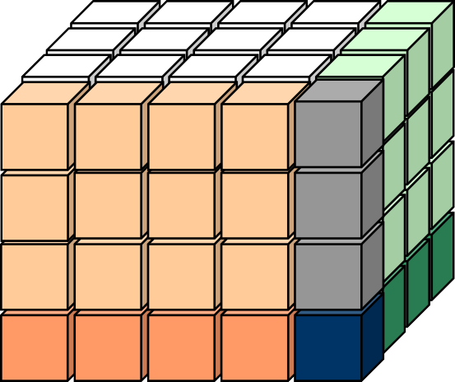




3. （Basic Concepts of Data Warehouse）
3.4 (multidimensional analysis0
3.4.1 (cube)
(cube table case)
时间 | 地区 | 销售渠道 | 销售额
J1 | 北京 | 批发 | 1200
J1 | 北京 | 零售 | 2300
J1 | 上海 | 批发 | 1233
J1 | 上海 | 零售 | 2122
… | … | …
J2 | 北京 | 批发 | 3312
J2 | 上海 | 批发 | 3423
… | … | …
(Time)
J1 J2 J3 J4 sum
(area)
北京.
上海
批发
广东
sum
零售
… ...
Sales channels
sum
Cube
(elational Table and Multidimensional Cube)

Slide 39
3. （Basic Concepts of Data Warehouse）
3.4 (multidimensional analysis)
3.4.2 (OLAP Multidimensional Data Analysis)
1. (Slice and Dice)
(In the multi-dimensional data structure, the required data can be obtained by slicing in two dimensions and dicing in three dimensions. For example, by dicing and slicing in the "city, product, time" three-dimensional cube, the sales of each city and each product can be obtained.)
2. (Drill)
(Drilling includes drill-down (Drill-down) and drill-up (Drill-up)/roll-up (Roll-up) operations, and the drilling depth corresponds to the level divided by the dimension.)
3. (Rotate)/ (Pivot)
(Data from different viewing angles can be obtained by rotating.)

Slide 40
3. （Basic Concepts of Data Warehouse）
3.4 (multidimensional analysis)
3.4.2 (OLAP Multidimensional Data Analysis)
1.切片
产品销售
情况
选定两个维：产品维和地区维
2021年11月产品销售情况
时间维
产品维
数据切片
产品维
地区维
地区维

Slide 41
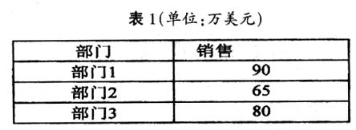
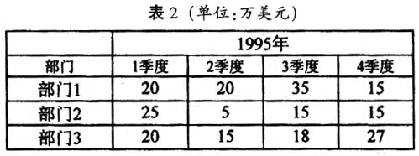
3.（Basic Concepts of Data Warehouse）
3.4 (multidimensional analysis)
3.4.2 (OLAP Multidimensional Data Analysis)
2。 (roll up, drill down)
(Drill up by time dimension)
60
(Drill down by time dimension)

Slide 42
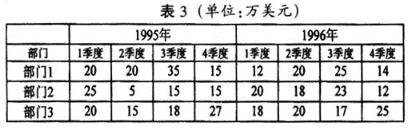
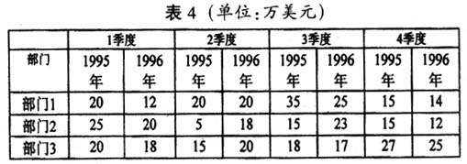
3. （Basic Concepts of Data Warehouse）
3.4 (multidimensional analysis)
3.4.2 (OLAP Multidimensional Data Analysis)
3. (rotate)

Slide 43
3. (rotate)
 | (year 2002) |  |  |  | (year 2003)
 | (1st quarter) | (2nd quarter) | (3rd quarter) | (4th quarter) | (1st quarter) | (2nd quarter) | (3rd quarter) | (4th quarter)
Beijing | 123 | 56 | 45 | 66 | 134 | 56 | 23 | 55
Shanghai | 134 | 103 | 98 | 87 | 102 | 139 | 97 | 82
Tianjin | 67 | 73 | 59 | 96 | 73 | 69 | 62 | 94
 |  | (Beijing) | (Shanghai) | (Tianjin)
(year 2002) | (1st quarter) | 123 | 134 | 67
 | (2nd quarter) | 56 | 103 | 73
 | (3rd quarter) | 45 | 98 | 59
 | (4th quarter) | 66 | 87 | 96
(year 2003) | (1st quarter) | 134 | 102 | 73
 | (2nd quarter) | 56 | 139 | 69
 | (3rd quarter) | 23 | 97 | 62
 | (4th quarter) | 55 | 82 | 94

Slide 44
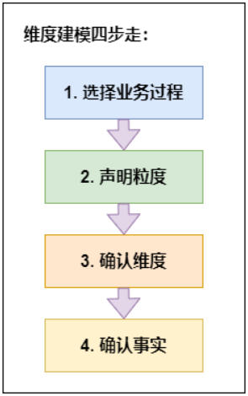
4. (How to Build a Data Warehouse)
4.1 (Four-step approach to dimensional modeling)
(The table types of dimensional modeling include fact table and dimension table; the optional models include star model and snowflake model, but in actual business, we are given a bunch of data, how do we use this data for data warehouse construction?)
(Based on more than 60 years of actual business experience, the author of Data Warehouse Toolbox summarizes the four steps of dimensional modeling in "Data Warehouse Toolbox")

Slide 45
4. (How to Build a Data Warehouse)
4.1 (Four-step approach to dimensional modeling)
1. (Choose a business process)
(Dimensional modeling is closely related to the business, so it must be modeled based on the business. Then, selecting a business process, as the name suggests, is to select the business we need to model in the entire business process, according to the needs provided by the operation and future scalability. wait to choose business)
(For example, in a mall, the entire mall process is divided into merchant side, user side, and platform side. The operational requirements are the total order volume, the number of orders, and the purchase status of users, etc. When we choose the business process, we select the data of the user side. consider. Business selection is very important because all subsequent steps are based on this business data)

Slide 46
4. (How to Build a Data Warehouse)
4.1 (Four-step approach to dimensional modeling)
2. Declarative Granularity
(In dimensional modeling, we are required to have the same granularity in the same fact table, and do not mix different granularities in the same fact table, and create different fact tables with different granularity data.)
(When fetching data from a given business process, it is strongly recommended to start with a focus on atomic granularity, that is, the smallest granularity, because atomic granularity can withstand unpredictable user queries.)

Slide 47
4. (How to Build a Data Warehouse)
4.1 (Four-step approach to dimensional modeling)
3. (confirm dimension)
(he dimension table is used as the entry and descriptive identification of business analysis, so it is also called the "soul" of the data warehouse. How to identify which are dimension attributes in a pile of data? If the column is a description of a specific value, is a text or constant, a participant in a constraint and row identification, then the attribute is often a dimension attribute.)
(As long as the granularity of the fact table is firmly grasped, all possible dimensions can be distinguished, and to ensure that there is no duplicate data in the dimension table, the dimension primary key should be uniqueMore about this source textSource text required for additional translation information)

Slide 48
4. (How to Build a Data Warehouse)
4.1 (Four-step approach to dimensional modeling)
4. (confirm the facts)
(The fact table is used to measure, and the measures are basically represented by quantitative values. Each row in the fact table corresponds to a measure, and the data in each row is a specific level of detail data, called granularity.)
(One of the core principles of dimensional modeling is that all measures in the same fact table must have the same granularity. This ensures that there are no issues with double-counting measures.)
(The most practical facts to remember are the numeric types and the additive class facts. So you can analyze whether the column is a measure that contains multiple values and is a participant in the calculation, in which case the column is often a fact.)

Slide 49
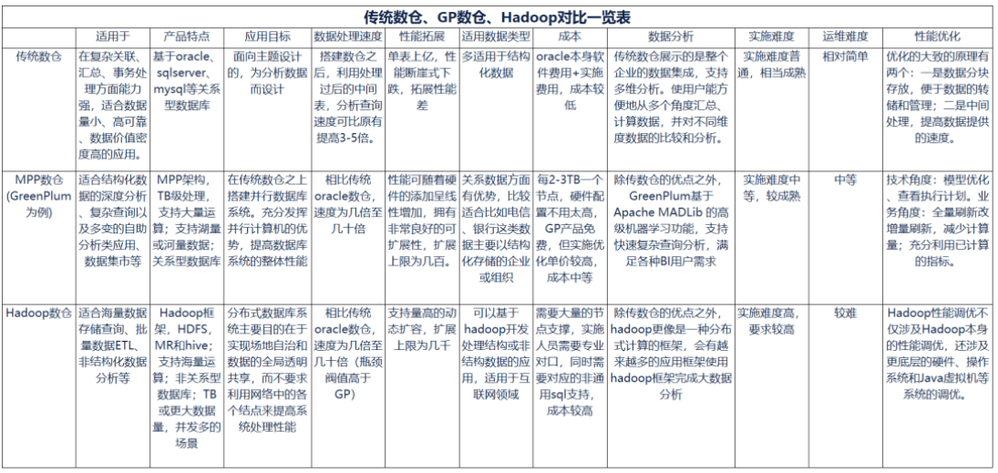
4. (How to Build a Data Warehouse)
4.2 (Application of big data technology in data warehouse)
4.2.1 (Comparison of three digital warehouse technologies)

Slide 50
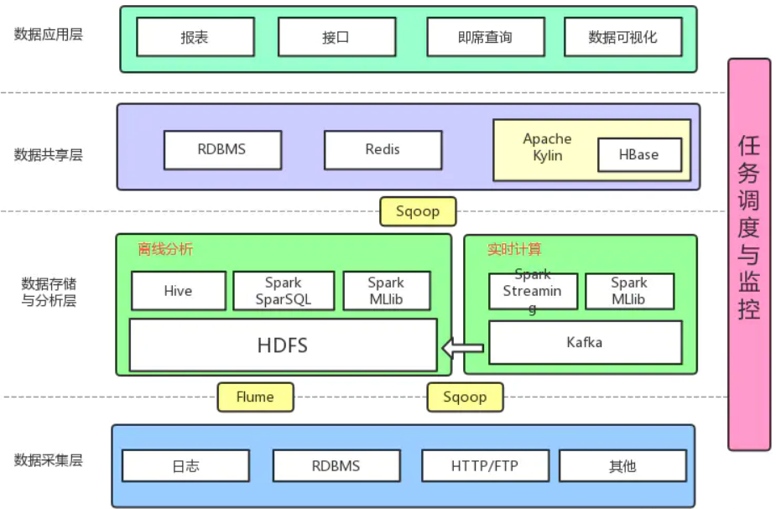
4. (How to Build a Data Warehouse)
4.2 (Application of big data technology in data warehouse)
4.2.2 (Data warehouse overall Hadoop techno)logy architecture

Slide 51
4. (How to Build a Data Warehouse)
4.2 (Application of big data technology in data warehouse)
4.2.3 (Hadoop data warehouse technology selection)
1 (Data acquisition layer)
(Collect and store data from various data sources until data is stored on the Hadoop-based distributed file system HDFS, during which ETL operations are performed.)
-> (Log collection: Generally, Flume is used to collect logs.)
(Flume Advantages)
(It has high real-time performance and can connect to various data targets such as HDFS Hive HBase Kafka; Flume's pipeline is based on transactions, which ensures the consistency of data transmission and reception. Flume is reliable, fault-tolerant, manageable, and customizable.)
(Flume Cons)
(Flume's configuration is cumbersome and inconvenient to manage)
(Relational data: use Sqoop to synchronize data in RDBMS and NoSQL to HDFS)
(Advantages of Sqoop)
(The bottom layer is the MapReduce task, which is suitable for mass data migration)
(Sqoop Disadvantages)
(The framework is heavier and the task startup is slow;)
(Only applicable to RDBMS<=>Hadoop components; cannot be used between Hadoop components;)

Slide 52
4. (How to Build a Data Warehouse)
4.2 (Application of big data technology in data warehouse)
4.2.3 (Hadoop data warehouse technology selection)
2 (2 Storage and Analysis Layer)
(This layer mainly includes offline computing + real-time computing)
(Storage system: Based on the Hadoop distributed file system HDFS, the data of the collection layer is stored)
(Messaging system: join Kafka to prevent data loss)
（Offline computing: It is a part that does not require high real-time performance. Usually, the calculation results are stored in Hive. The offline computing technology is mainly Hive, Spark, and some use Tez.）
(Real-time computing: Storm and Spark were more popular in the past few years. In recent years, they have transformed to Flink. Usually, Spark Streaming and Flink are used to consume log data collected in Kafka, and then the results are stored in Redis through real-time computing.)
（Machine Learning: Machine Learning Algorithms with Spark Mllib）

Slide 53
4. (How to Build a Data Warehouse)
4.2 （Application of big data technology in data warehouse）
4.2.3 （ Hadoop data warehouse technology selection）
3 （ data sharing layer）
（The data analysis and calculation results through offline and real-time computing are stored in the data sharing layer, which is the data sharing layer, and is mainly used as the data distribution and scheduling center. Because the results of analysis and calculation through Hive, MR, Spark, and SparkSQL are stored in HDFS, it is impossible for businesses and applications to obtain data directly from HDFS.）
（ OLAP analysis engine）
（Kylin: multi-dimensional analysis engine,）
（Advantages: pre-computing, calculating each cube in advance, fast query, second-level delay;）
（Disadvantages: Because it is calculated in advance, it is not flexible enough to query flexibly, exploratory query）
（Hive: The Tool of Choice for Big Data Warehouses）
(Advantages: PB-level batch query tool, high SQL support)
(Disadvantages: high latency, usually minutes, or even hours; only HDFS data can be accessed)
(Presto: a supplementary tool for Hive, the data magnitude is smaller than that of Hive)
(Advantages: Based on memory, the operation efficiency is higher than Hive)
(Disadvantages: memory-based, memory overflow when joining large tables;)
(Impala: a supplementary tool for Hive, the data magnitude is smaller than that of Hive, and it is usually one of two options with Presto) (Advantages: Based on
memory, the operation efficiency is higher than Hive)
(Disadvantages: memory-based, memory overflow when joining large tables;)

Slide 54
Add a title
Thanks!

